Slide 1
Egocentric Network Typologies
Bases for Research
with NetHealth Data
Matthew J. Chandler
April 4, 2019

Slide 2
Background Themes and Questions (1 of 2)
Ego Characteristics
What types of people have low/high degree?
Why do most people have homophilous ties?
What kind of person has heterophilous ties?
What types of people have strong/weak ties?
What difference does it make to know lots of different people who don’t know each other?
What types of positions have similar local network structures?
Social Capital and Class
What types of people are central/peripheral?
What types of people bridge structural holes?
What types of network positions give power/wealth advantages?
What types of local network structures correspond with vibrant civil society and democratic development?
Can prosocial outcomes be cultivated? How?

Slide 3
Background Themes and Questions (2 of 2)
Tie Characteristics
How many close/distant relationships can people maintain?
What shapes the formation of different types of relationships?
How long do different types of ties last?
What makes a tie stronger/weaker?
Are embedded ties stronger & longer-lasting?
Influence and Diffusion
What types of ties/alters are most influential?
Are there universal structures that form in various types of networks? How?
Which structures are susceptible/resistant to diffusion of different types of contagions?
What types of interventions can limit negative diffusion or encourage positive diffusion?

Slide 4
Recent Research on Egocentric Network Typologies
Relationship-Based Typologies
Driven by life course and social support research.
The Convoy Model
Antonucci, Ajrouch, & Birditt (2013)
Huxhold, Fiori, & Windsor (2012)
UCNets Data
Giannella & Fischer (2016)
Offer & Fischer (2018)
Related research
Social Networks and the Life Course (2018) edited volume
Especially: Youm, Laumann, & Lee (2018)
Structural Typology
Developed from longitudinal study of young adults.
Inductive Typology of Personal Networks
Bidart, Degenne, & Grossetti (2018)
Related recent research
Brashears & Quintane (2018)
McFarland, et al. (2014)
Small (2017)
Related older research
Structural equivalence & blockmodeling

Slide 5
Opportunities with NetHealth Data
Advantages
Long duration with dense observations
Multiple measures of egocentric networks
Whole network data for in-study ties
Extensive attributes for all ties and alters
Can tackle both relationship and structural typologies with unprecedented depth
Potential Impact
Ascertain the relative salience of different egocentric network typologies
Develop an integrated typology
Add robustness to inductive methods
Link egocentric network types to health qualities and behavioral dynamics

Slide 6
Related Explorations To-Date
Tie Strength
Cross-tabs on closeness, frequency, duration, relationship type, support type, etc.
Linked to communication over prior 90 days
Degree Dynamics
Clustering trajectories
Predicting with personality metrics
Relationality / Schematic Distance
Initially to explore tie strength and homophily
Led into critique of Goldberg and a deep dive into the robustness of clustering techniques
Lattice Analysis
Initially to mine nominal data (e.g., activities)
Led to new algorithm, with wider applications
Lessons Learned:
Clustering methodology is a minefield, and sociologists need more guidance
Techniques for finding abstract patterns, such as schematic distance and lattice analysis, are ripe for theory-driven work
The network survey data alone are too spotty for robust inductive typologizing
A lack of clusterability could be considered a finding in itself

Slide 7
Current Initiative
Theoretical Weaving
Distinctions that make a difference
Well known that personality interacts with network position and local configurations
Also established that tie strength and support correspond to access/proximity
And of course, “strength of weak ties”
Setting the scope
Given the research on life course and young adulthood, the context of our subjects implies a rather limited scope
But still, an interesting and important scope: networks of high-achieving resident college students, about to enter early careers
Ongoing Empirical Work
Multiplex data from record linkage
Network surveys
At least 5 types of communication
Complete linkage in progress
Comparison of standard clustering methods (e.g., k-means) and various alternatives (e.g., schematic distance)
No conclusions yet
Also preparing for a nuanced conclusion that high-achieving resident college students defy reductive classification

Slide 8
Replicating Closest-Related Studies
Giannella & Fischer (2016)
NCCS Data from late ‘70s
1050 subjects in Bay Area
10-12 name generator questions
Multiple follow-up questions
Many related tie-oriented questions
Clustered using 43 hand-picked variables
Clustered variables, and pruned down to 21
Chose 7 reduced dimensions, and named them
Clustered persons by 7 dimensions
Chose 11 final clusters, and named them
Organized 11 clusters into 3 main types:
Kin-dominant (3)
Nonkin-dominant (2)
Small-network (2)
The 43 select variables encompassed:
Degree of support (12/13)
Pre-segmented by kin/nonkin
Geographic distance (5/5)
Pre-segmented by kin/nonkin
Homophily (3/6)
Pre-segmented by demographics
Contexts/foci (2/6)
Pre-set foci (e.g., work, church)
Social styles (0/5)
Pre-set locations for socializing
Tie strength or closeness (0/8)
Duration, frequency, closeness
Role/exchange multiplexity
Mostly pre-segmented by kin/nonkin

Slide 9
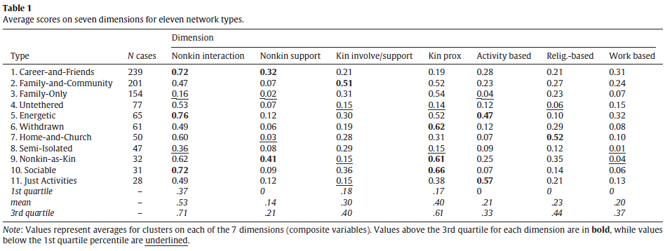
Replicating Closest-Related Studies
Giannella & Fischer (2016)

Slide 10
Replicating Closest-Related Studies
Giannella & Fischer (2016)
Kin-dominant Type
Family-and-Community
Family-Only
Home-and-Church
Nonkin-dominant Type
Career-and-Friends
Energetic
Small-network Type
Untethered
Withdrawn
Residual
Semi-isolated
Nonkin-as-Kin
Sociable
Just Activities
Convoy Model Comparison
Similar Types
Diverse and superficial
Socially-isolated
Friend or community
Family
Different Key Metrics
Self-assessed closeness central for Convoy model, but not used by Giannella & Fischer

Slide 11
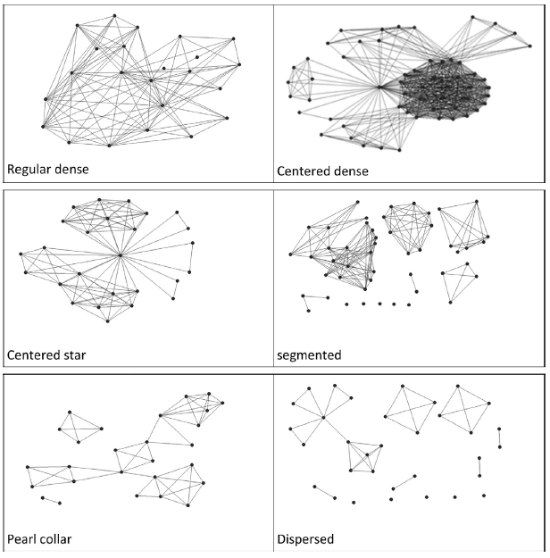
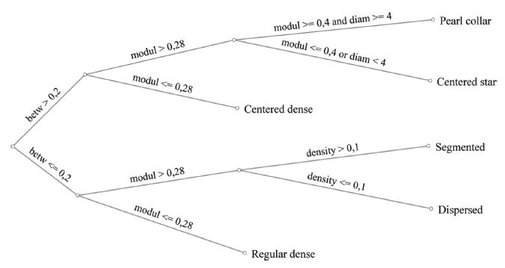
Structural Typology of “Personal Networks”
Bidart, et al. 2018. “Personal Network Typologies.” Social Networks 54: 1-11.

Slide 12
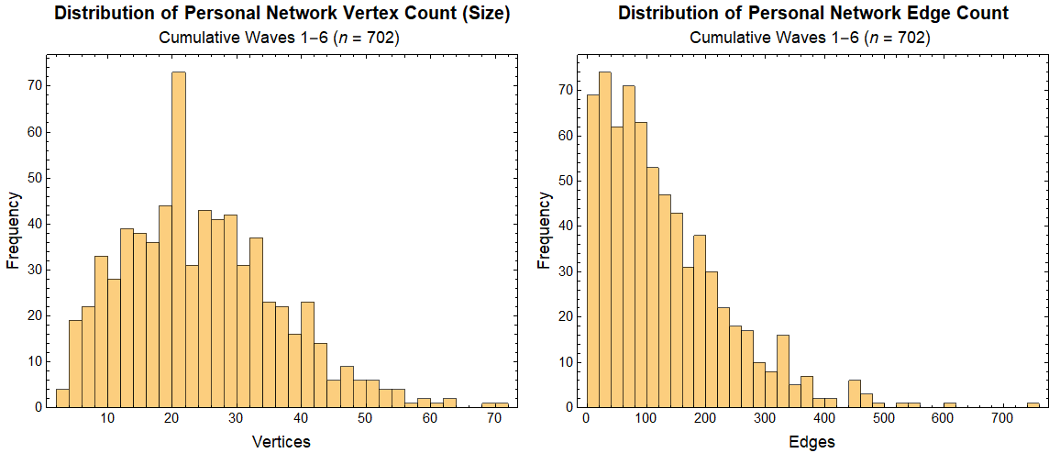
Personal Networks from Network Surveys

Slide 13
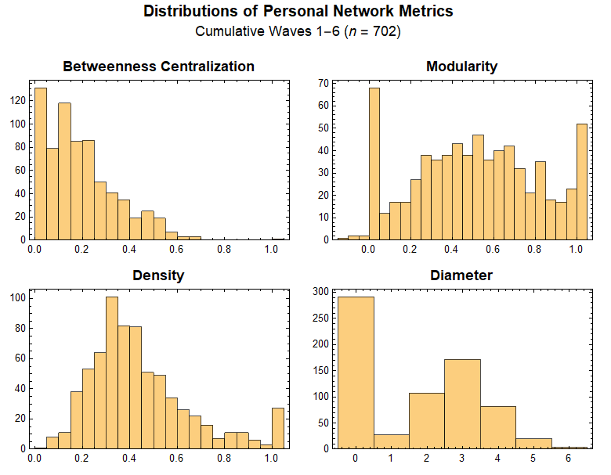
Personal Networks from Network Surveys

Slide 14
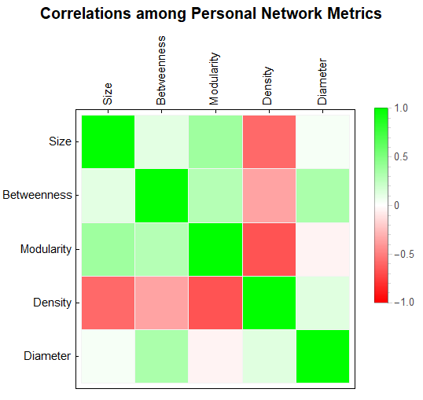
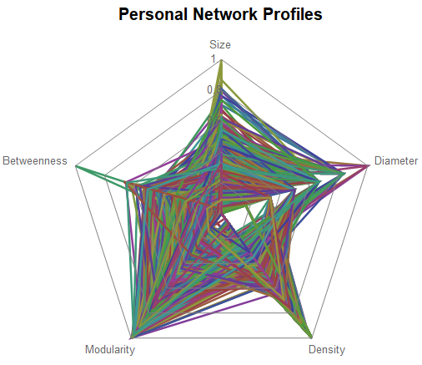
Personal Networks from Network Surveys

Slide 15
